Slide 1
Satellite retrievals of total column water vapor and clouds
P2: Observation-based weather analysis
and Nowcasting (QPN)
Cintia Carbajal Henken
Freie Universität Berlin
RealPEP 2 Kick-off meeting
2 February 2022, DFN/Berlin
Notes:
Welcome
Review panel
-representative of the DFG senate
-representative of the DFG review board
-people from the DFG headquarters
-reviewer for coming from abroad
mention institutions contributing to the research unit
mention 2018

Slide 2
Objective
Objective:
develop an observation-based ensemble nowcasting scheme, which makes use of microphysical process detection and tendencies derived from polarimetric weather radar and satellite observations to significantly enhance lead time and skill.
H4: Exploitation of the OLCI-Sentinel-3 and MTG-FCI observational capabilities with their higher spatio-temporal resolution will further advance CI detection in both clear-sky and cloudy regions.
H5: Information on potential convective initiation estimated from satellite cloud and total water vapor column retrievals, can be succesfully exploited as a proxy for future new cells, which increases the lead time of radar-based nowcasting.
Notes:
alleine starten lassen

Slide 3
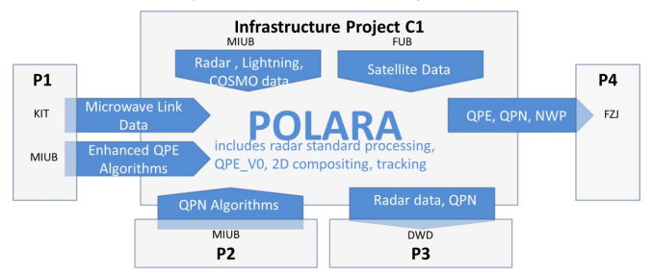
Review
FUB was in C1 infrastructure project in phase 1
Now in P2!
Collecting, developing and processing satellite-based observations of total column water vapor (TCWV) and clouds.
OLCI TCWV product
MSG-SEVIRI TCWV & cloud product
Towards MTG-FCI TCWV product
→ Using passive VIS/NIR/TIR measurements!
Match-up dataset, including GPS, for statistical study on relationship between observed variability in TCWV fields and cloud development at later time steps.
Notes:
alleine starten lassen

Slide 4
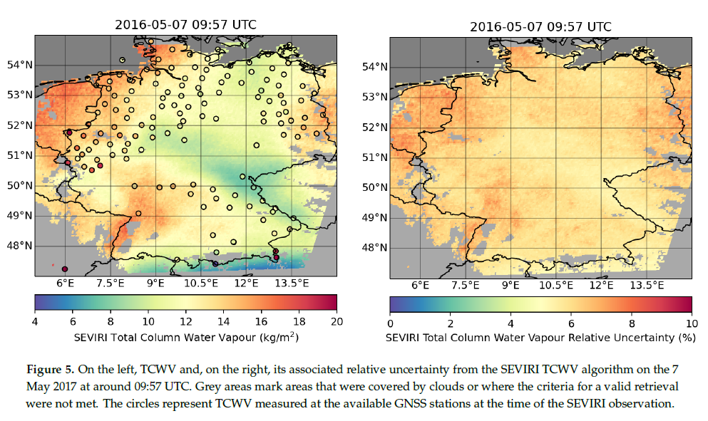
MSG-SEVIRI TCWV retrievals
Daytime TCWV+T_{s} from IR split-window measurements at 11 and 12 μm
Forward model (RTTOV) embedded in OE method
→ TCWV uncertainties
From El Kassar, Carbajal Henken & Preusker, 2021
Notes:
alleine starten lassen

Slide 5
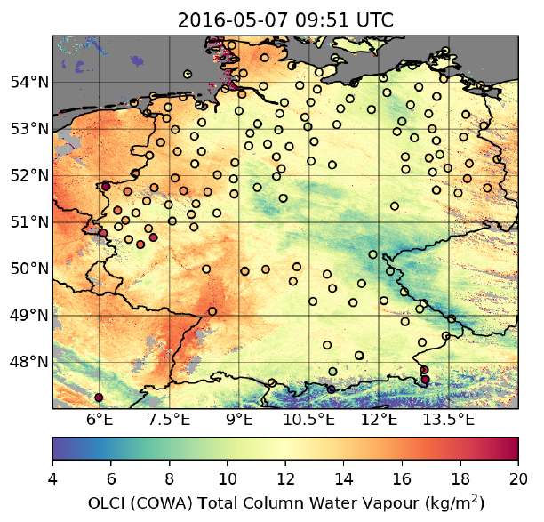
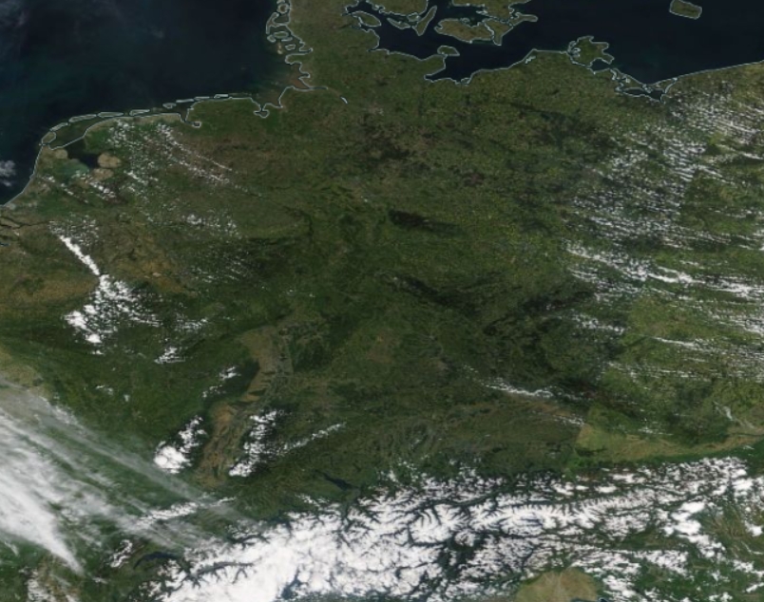
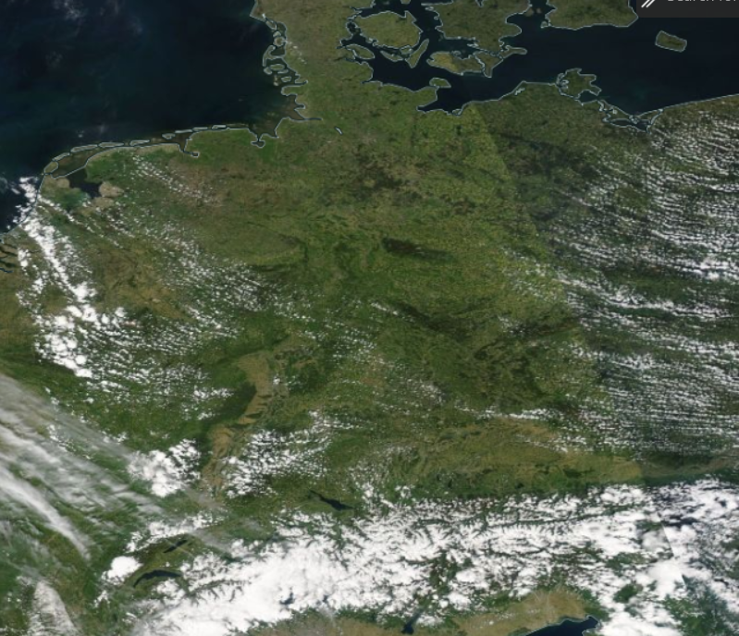
MSG-SEVIRI TCWV retrievals
Comparison of SEVIRI ~4x7km² TCWV to the OLCI COWa 300x300m² TCWV
Terra 11 UTC
Aqua 12.50 UTC
From El Kassar, Carbajal Henken & Preusker, 2021
Notes:
alleine starten lassen

Slide 6
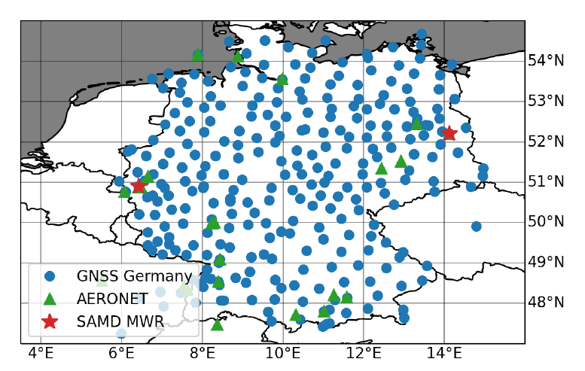
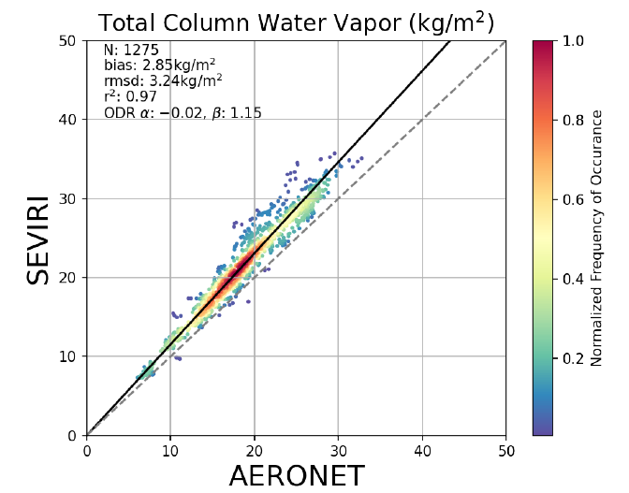
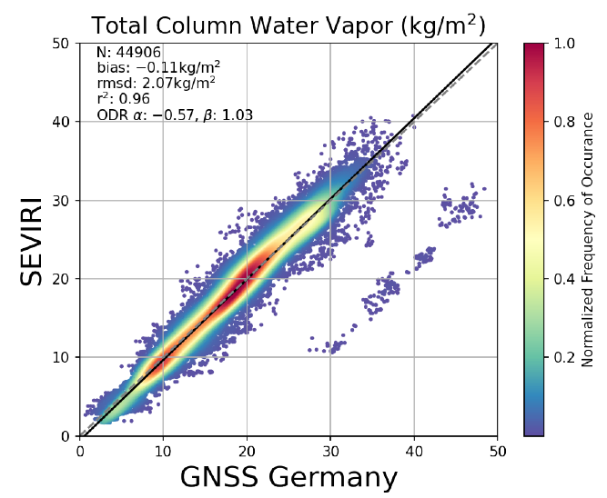
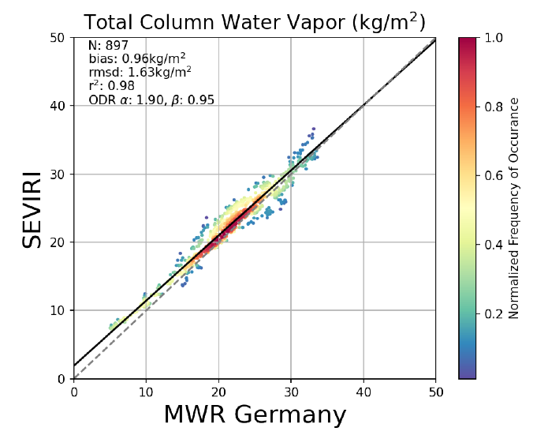
MSG-SEVIRI TCWV retrievals
Validation study with ground-based observations in Germany
Absolute biases between 0.11 and 2.85 kg/m²
RMSD between 1.63 and 3.24 kg/m²
PC between 0.96 and 0.98
From El Kassar, Carbajal Henken & Preusker, 2021
Notes:
alleine starten lassen

Slide 7
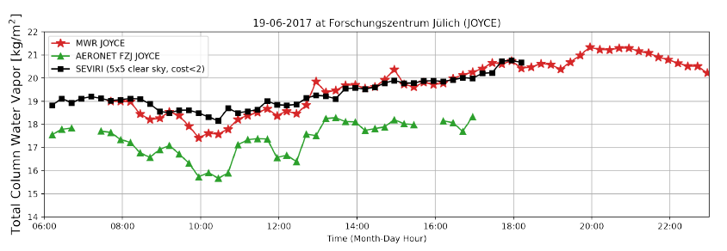
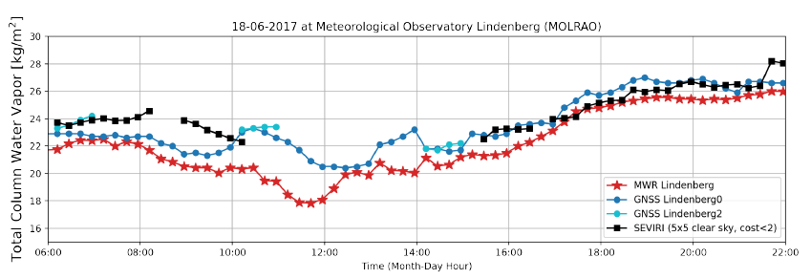
MSG-SEVIRI TCWV retrievals
Investigating SEVIRI TCWV capabilities in relation to observing diurnal cycles and temporal variabilities
Examples for semi-clear days (some cirrus and cumulus clouds)
SEVIRI TCWV mostly within uncertainty range of ground-based observations
Notes:
alleine starten lassen

Slide 8
NWC-SAF Software
NWC SAF (EUMETSAT) provides SW Package for generating satellite products with direct application in nowcasting (GEO v2018)
Input: MSG-SEVIRI measurements, NWP data
GEO products regarding convection: storm monitoring at different development stages:
Any time: several cloud products like CT and CTTH
Pre-convective: iSHAI (imaging Satellite Humidity and Instability)
Convective Initiation: CI
Developing convective storm: RDT (Rapid Developing Thunderstorm)
Notes:
alleine starten lassen

Slide 9
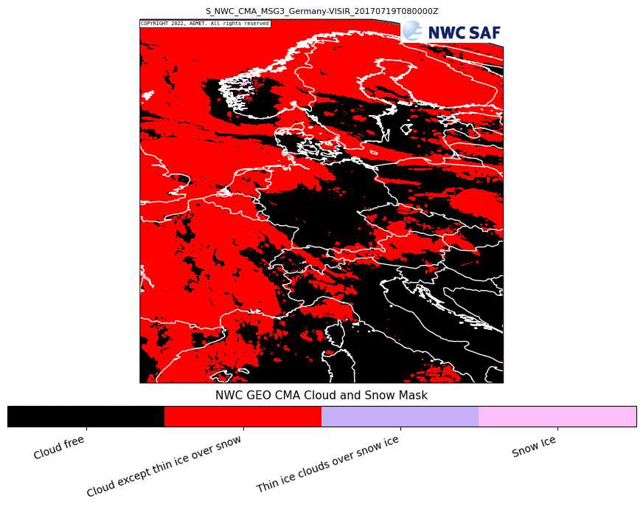
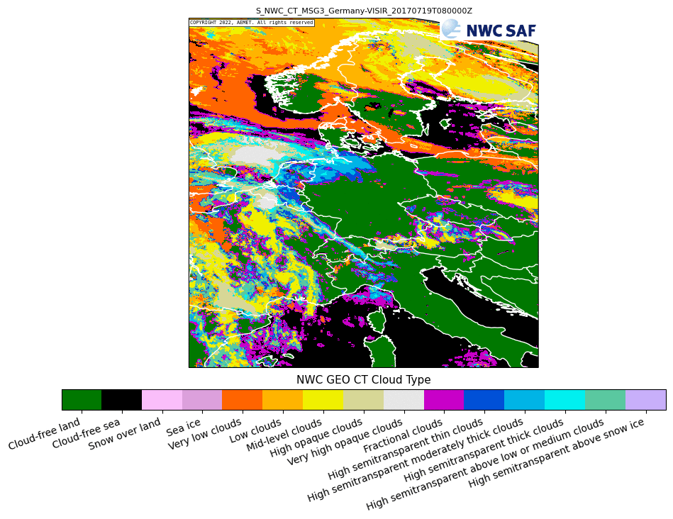
NWC-SAF Software
Notes:
alleine starten lassen

Slide 10
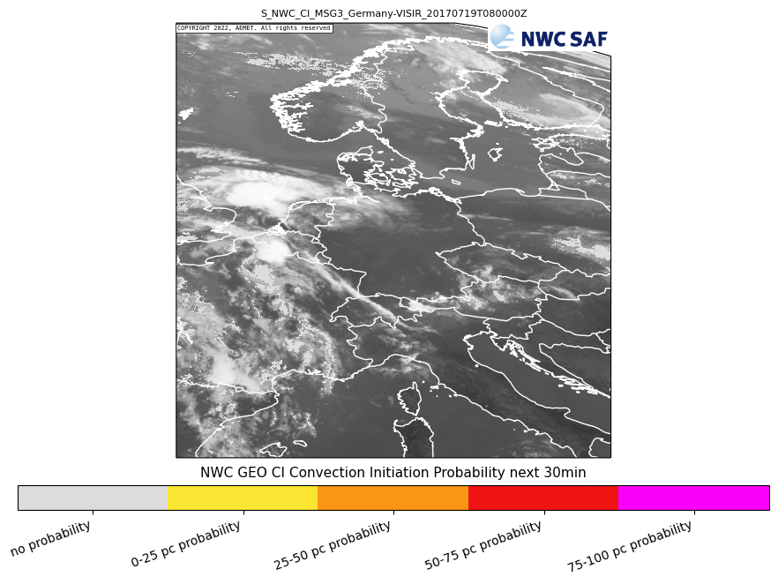
NWC-SAF Software
CI
1) Warm cell detection
2) Tracking to compute dynamic trends: BT criteria’s related to vertical extension, updrafts, glaciation
Validation studies with radar objects
4 classes of probability
3 forecast periods
Notes:
alleine starten lassen

Slide 11
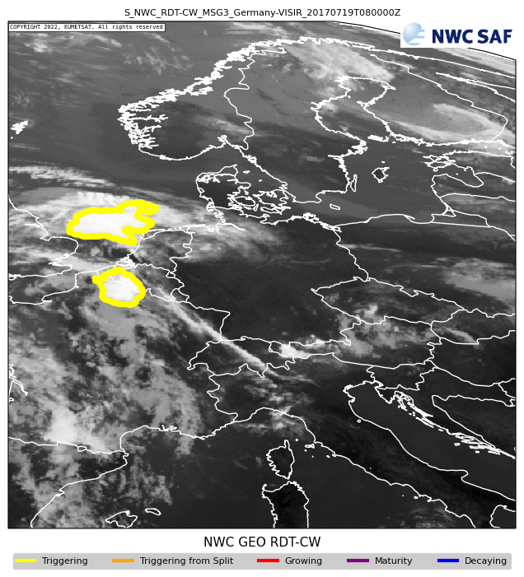
NWC-SAF Software
RDT
Object-oriented analysis of satellite images: detection, tracking, discrimination, forecasting
Includes: overshooting tops, lightning jumps
From few pixels to large-scale
Multi-description of convection: yes/no convection, phase, position, overshooting tops, Rainfall activity, severity
Validation studies with radar obs and experts
Notes:
alleine starten lassen

Slide 12
NWC-SAF Software
Clear-sky CI probabillity → In-cloud CI probability → RDT
Notes:
alleine starten lassen

Slide 13
Current work & Outlook
Optimizing Retrieval Framework for OLCI/SLSTR and MSG-SEVIRI:
Flexible set-up
Fast (looking into option of only using LUTs as forward models)
Extent evaluation: ground-based obs, ICON fields (simulations for one clear-sky day provided by Klaus)
Application of OLCI TCWV fields: comparison of WV structure functions computed from different remote sensing obs (with Xavier Calbet, publication)
Towards MTG
Reader for new data format: done
EUMETSAT MTG User Workshop (May 2022)
WP-P2-4: Coherence of small-scale spatio-temporal TCWV variability (FUB, 1-30m)
WP-P2-3: Development of TCWV retrieval algorithm for MTG-FCI (FUB, 1-24m)
Notes:
alleine starten lassen

Slide 14
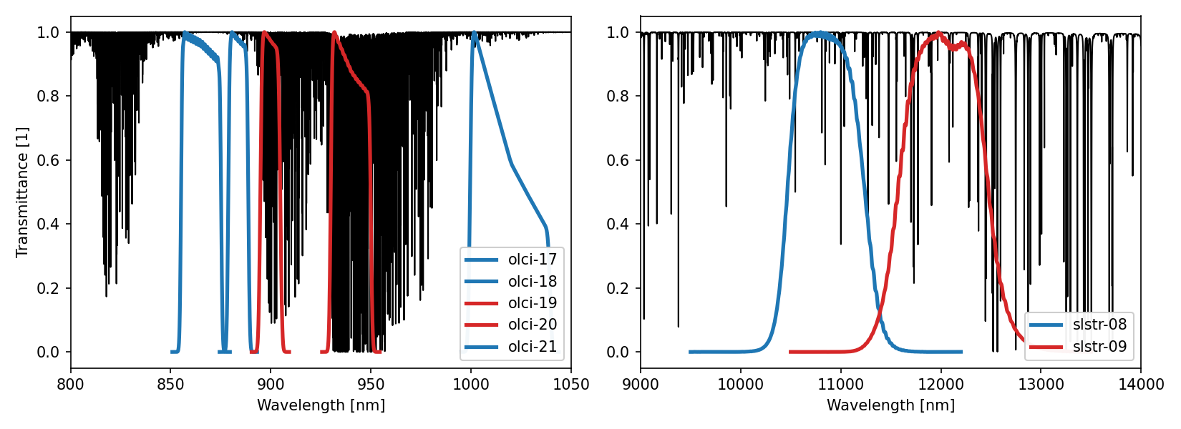
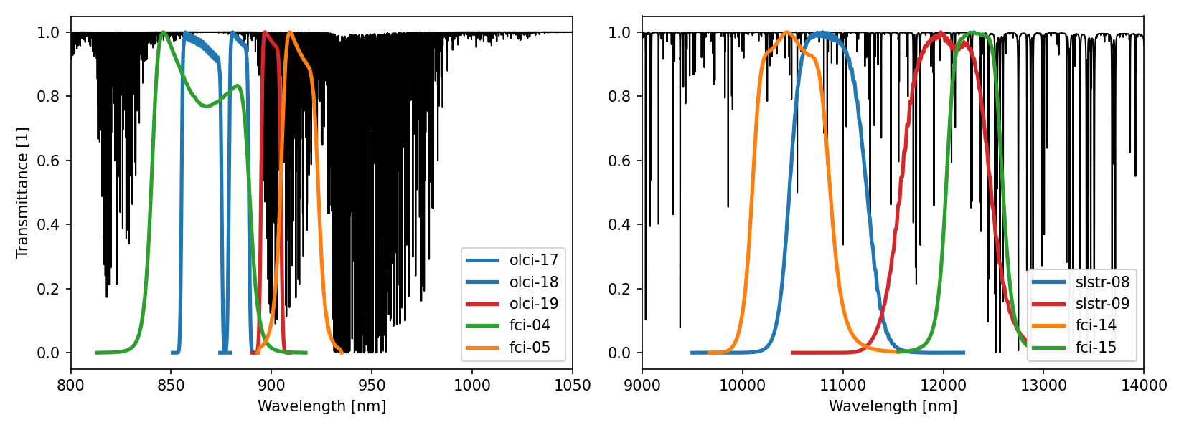
Current work & Outlook
Towards MTG: benefitting from TCWV MSG-SEVIRI and OLCI-SLSTR NIR-TIR retrievals
Provided by Jan El Kassar
Notes:
alleine starten lassen

Slide 15
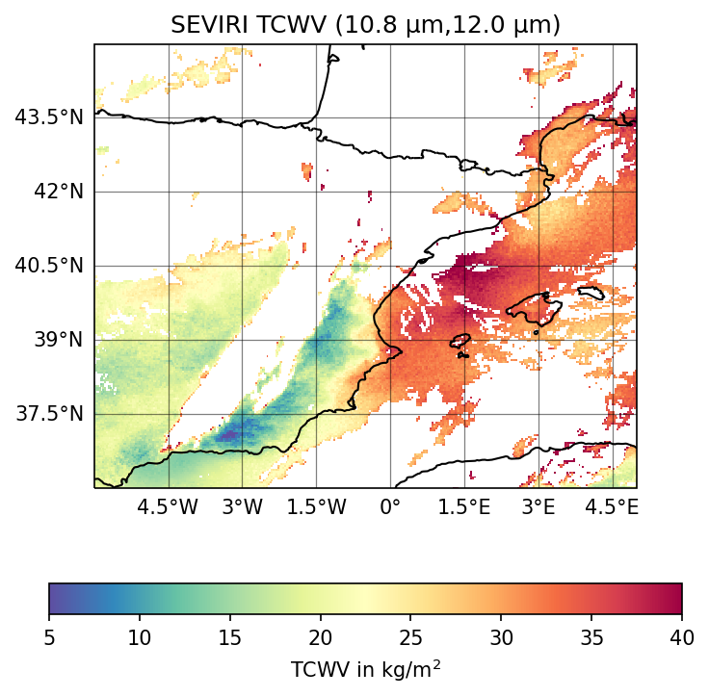
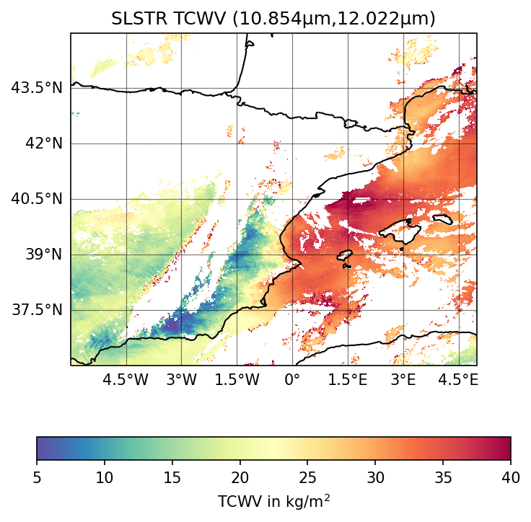
Current work & Outlook
Towards MTG: benefitting from TCWV MSG-SEVIRI and OLCI-SLSTR NIR-TIR retrievals
Provided by Jan El Kassar
Notes:
alleine starten lassen

Slide 16
Current work & Outlook
NWC-SAF Software: collecting satellite-based cloud/convection products
Improved cloud masking
Cloud typing
Convection products including tracking of cloud systems
WP-P2-3: Development of TCWV retrieval algorithm for MTG-FCI (FUB, 1-24m)
WP-P2-4: Coherence of small-scale spatio-temporal TCWV variability (FUB, 1-30m)
WP-P2-5: Advanced convective initiation detection (FUB, 12-36m)
Notes:
alleine starten lassen

Slide 17
Thanks!
Notes:
alleine starten lassen

Slide 18
Additional slides
Notes:
alleine starten lassen

Slide 19
WPs
WP-P2-3: Development of TCWV retrieval algorithm for MTG-FCI (FUB, 1-24m)
Newest imager observational capabilities for clouds and water vapor in Europe (2022)
NIR channels allow for improved TCWV retrievals → indicated by first RTTOV-based sensitivity studies (work in progress). Also improved cloud masking expected.
Set-up of TCWV processor for connection to POLARA
Publication
Notes:
alleine starten lassen

Slide 20
WPs
WP-P2-4: Coherence of small-scale spatio-temporal TCWV variability (FUB, 1-30m)
Investigation of relationships between small-scale spatial TCWV variability from OLCI and temporal variabilities from GPS and MTG-FCI for different weather conditions to further advance (WP-P2-5)
Assess whether similar relationships are observed in the ICON simulations
Assess impact of including satellite-based TCWV fields in NWP assimilation process (WP-P3-3).
Notes:
alleine starten lassen

Slide 21
WPs
WP-P2-5: Advanced convective initiation detection (FUB, 12-36m)
Increased spatio-temporal resolution of MTG-FCI will allow for more accurate identification of regions with increased CI probabilities at relevant time scales of minutes
Identify and establish new TCWV-based CI proxies to increase lead time of new developing convective cells in radar-based nowcasting (as described in WP-P2-6).
Preparation and provision of MTG-FCI cloud observations and derived cloud CI proxies for nowcasting of ´new convective cell development to increase lead times in precipitation nowcasting (WP-P2-6).
Preparation and provision of MTG-FCI cloud products and CI proxies for a machine-learning-based precipitation nowcasting method (WP-C1-2).
Set-up of CI processor for connection to POLARA
Publication
Notes:
alleine starten lassen

Slide 22
Cooperations
Internal cooperations
FUB with UniBonn within P2 on merging radar and satellite observations to improve precipitation nowcasting
FUB with P3 on ICON relationship and TCWV assimilation assessment.
FUB with C1 on machine-learning- and satellite-based precipitation nowcasting method
FUB and UniBonn with P1 and P4 within evaluation/feedback rounds.
External cooperations:
EUMETSAT
Andi Walther, RTTOV
(Rene Preusker, OLCI)
Xavier Calbet from AEMET: use of high resolution OLCI TCWV to assess impact of TCWV variability within larger IASI footprint on retrievals → publication
Notes:
alleine starten lassen

Slide 23
Challenges
MTG-FCI
Getting L1 and L2 data as quickly as possible once available
quick processing for producing CI statistics
Merging SPROGS QPN fields with RNN QPN fields obtained from satellite-based input data.
Obtaining sophisticated metrics on TCWV variability from OLCI
data gaps due to clouds, water surfaces (no retrievals)
Joint Evaluation
how will feedback from P3 and P4 for P2 look like?
What kind of evaluation/validation metrics are used, which ones are considered crucial?
How can the impact of single changes on the overall outcome be assessed (e.g. new QPN product with added value from satellite observations on new flood prediction simulations)
etc.
Notes:
alleine starten lassen

Slide 24
RNN P2 vs. C1
P2 alone is providing a combined nowcasting, which is SPROG with satellite-based CI information included. For that, C1 is only providing the technical set up of an RNN.
P2 uses the RNN to link satellite-based information on cell initiation with their subsequent development into QPE fields; this link is then used to enrich the SPROG nowcast with the new cells.
In parallel, C1 will provide a radar-only (QPE) and in a second step a radar-satellite-based nowcasting exclusively based on the training of a PredRNN.
Notes:
alleine starten lassen

Slide 25
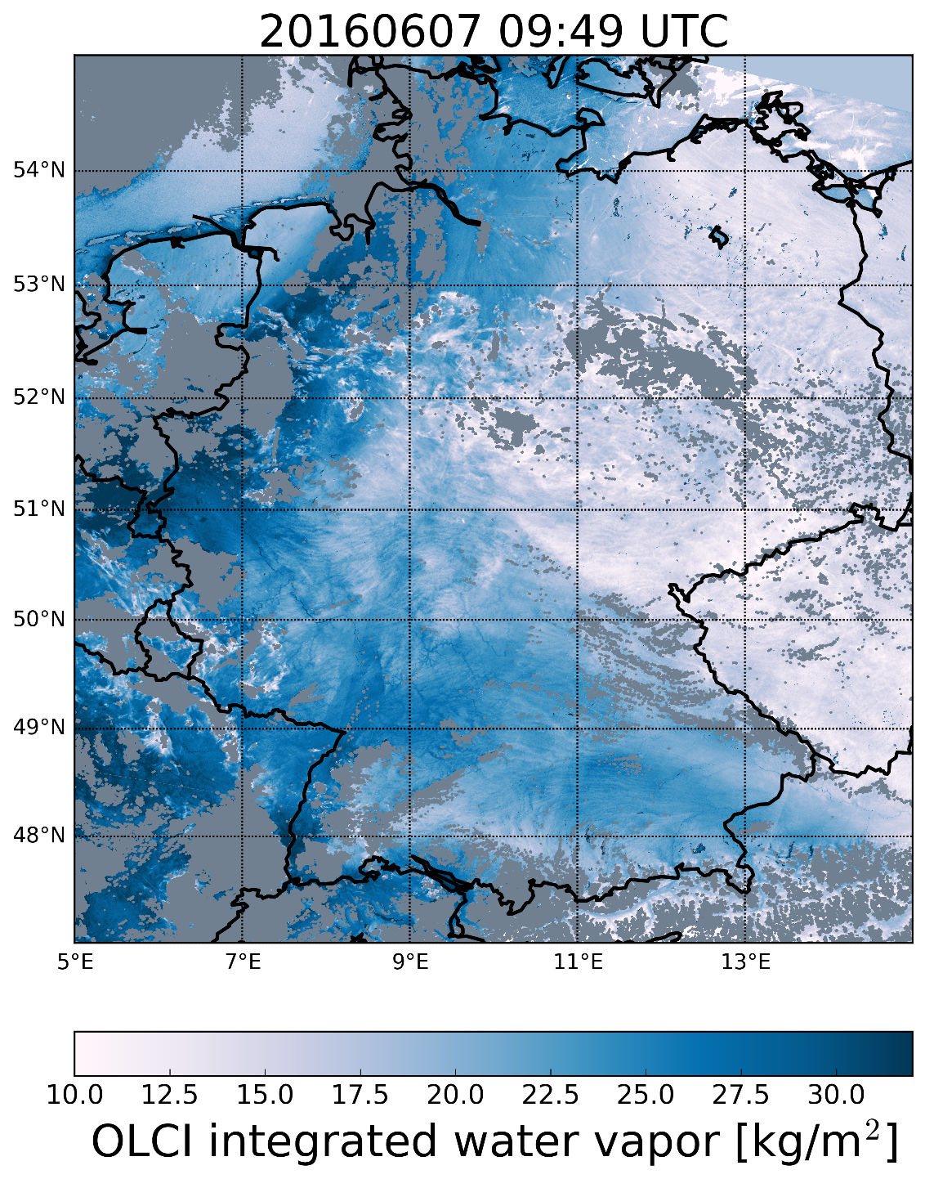
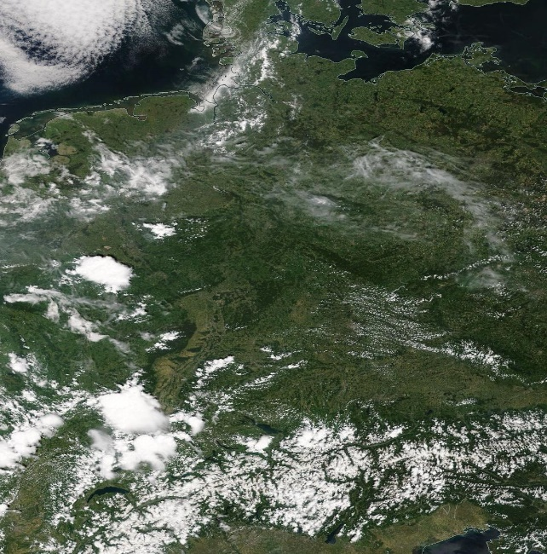
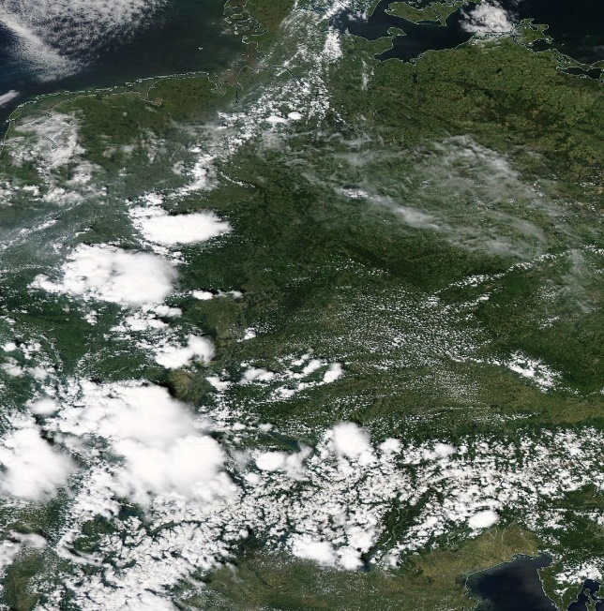
OLCI TCWV example
MODIS-Terra at 10.20 UTC
MODIS-Aqua at 12.05 UTC
Notes:
alleine starten lassen

Slide 26
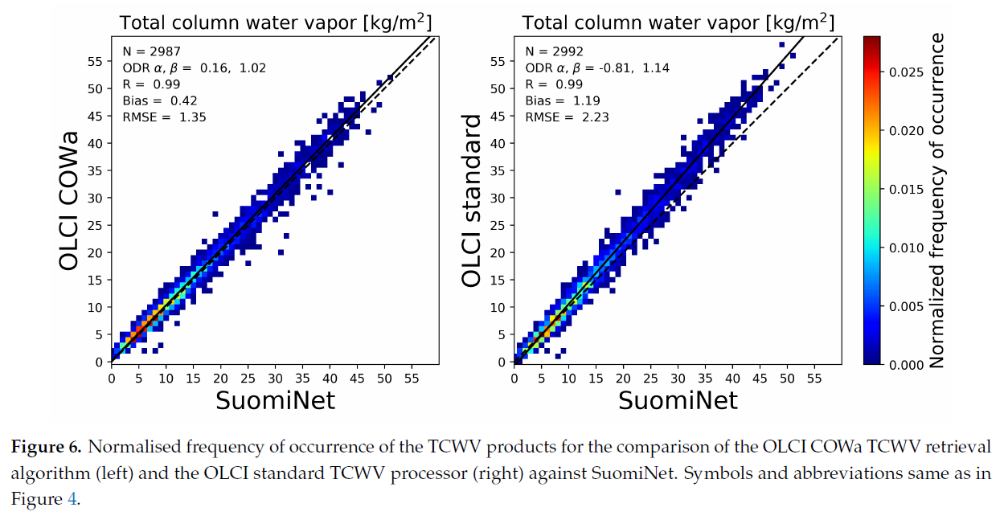
OLCI TCWV validation
Notes:
alleine starten lassen

Slide 27
Current work & Outlook
Notes:
alleine starten lassen

Slide 28
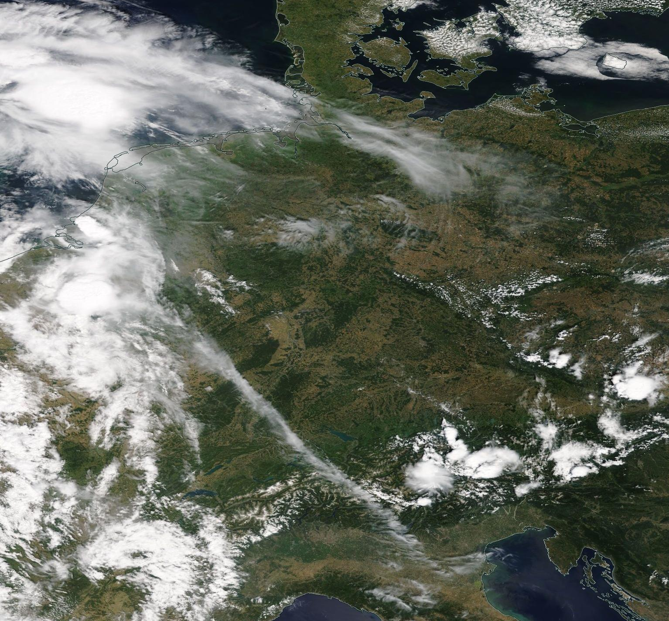
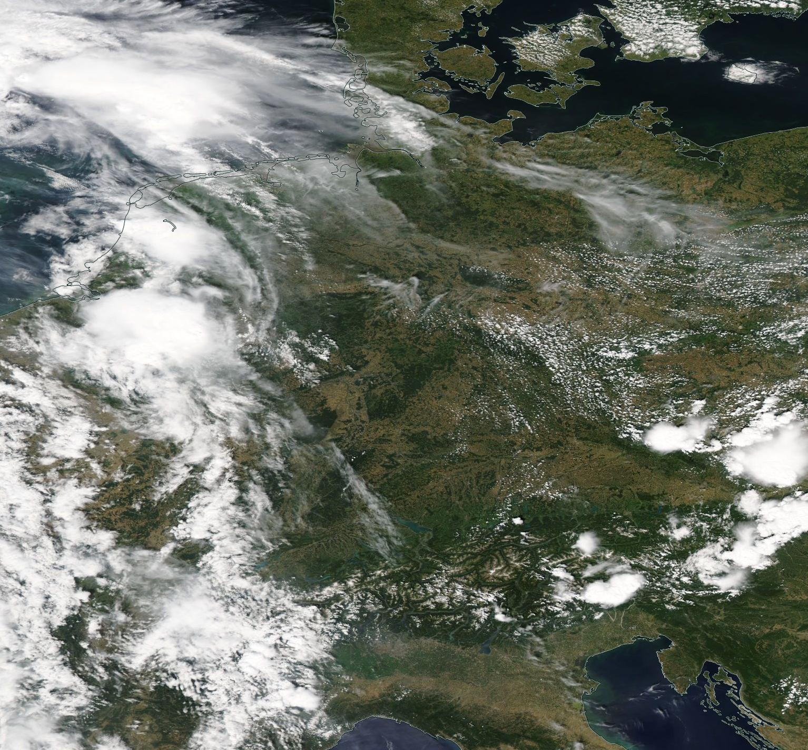
Case study day 19 July 2017
MODIS-Terra 10.25 UTC
MODIS-Aqua 12.15 UTC
Notes:
alleine starten lassen

Slide 29
Case study day 19 July 2017
Notes:
alleine starten lassen

Slide 30
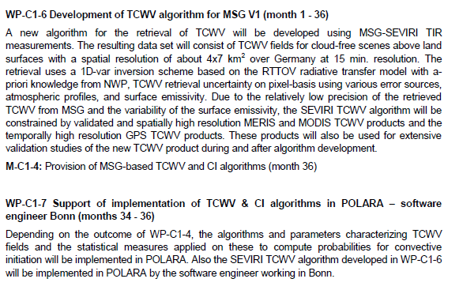
MSG-SEVIRI
MSG geostationary satellite, MTG follow-up mission (2022)
SEVIRI: passive imager with channels in VIS/NIR/TIR
Temporal resolution 15 min., spatial resolution ~4km x 7 km (in Germany)
Measurements used: Brightness temperatures (BTs) at 10.8 and 12 micron
Both window channels
Differential water vapor absorption
From Holmlund et al. 2004
Notes:
alleine starten lassen

Slide 31
Flow-chart MSG IWV-Ts retrieval
Pre-processing: prepare GPS data, MSG L1 native data, ERA5 data, emissivity maps
Save retrieval results + aux: IWV, Ts, uncertainties, lat/lon, viewing geometry, retrieval information
Read in global settings, paths to data, RTTOV etc.
Read in MSG L1 data
Get date, time step
Per pixel (lat, lon)
MSG cloud mask
Convergence?
Yes/no
Get retrieval info
Collect auxiliary data:
MSG L2 cloud data at time step
ERA5 hourly data
GPS at time step
Emissivity at date
No
All?
Yes
Clear-sky
Read in auxiliary data per pixel: ERA5,
Emissivity, GPS (apriori)
Inverse technique
With RTTOV as forward model
Notes:
alleine starten lassen

Slide 32
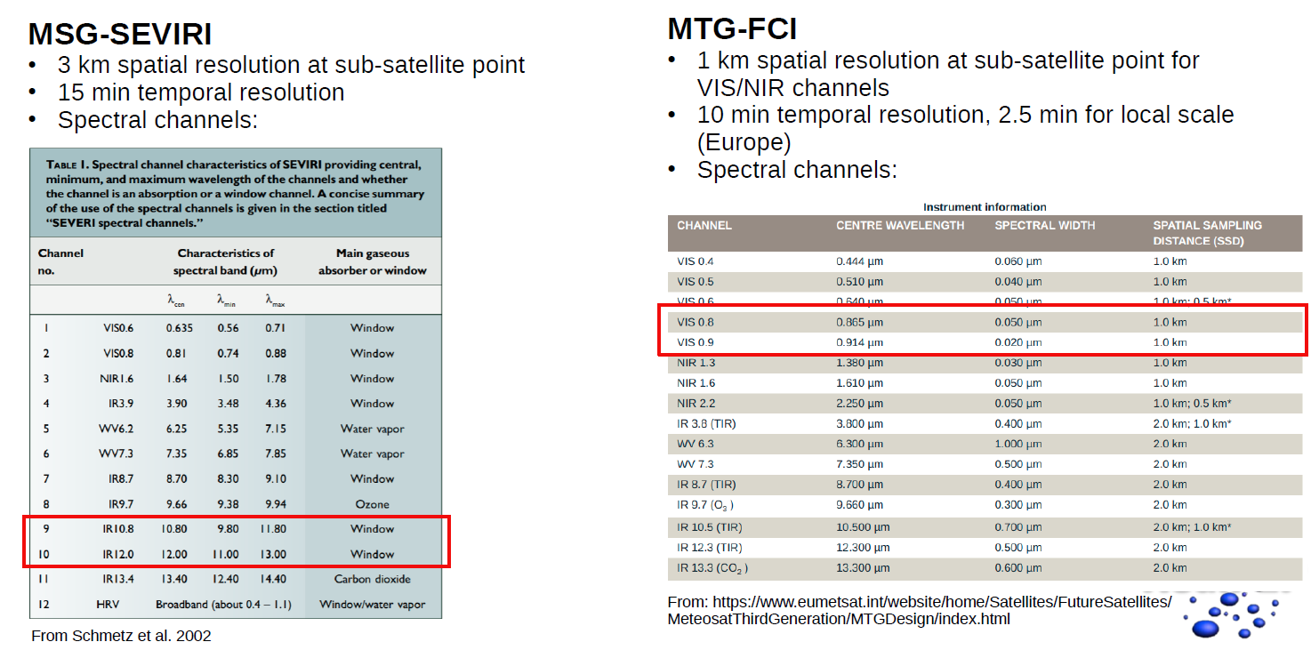
MSG-SEVIRI vs. MTG-FCI
Notes:
alleine starten lassen

Slide 33
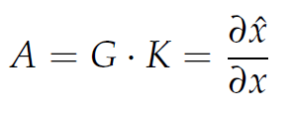
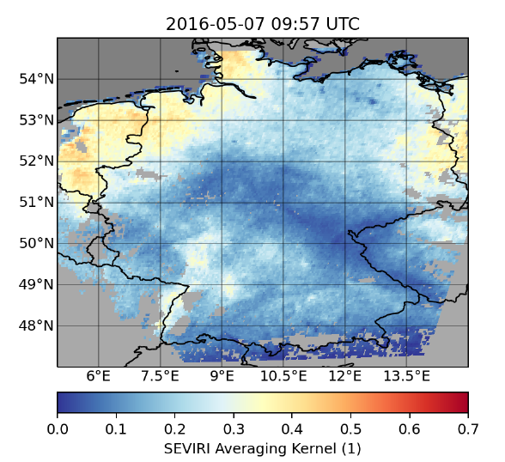
MSG-SEVIRI TCWV retrievals
Averaging Kernel
Values between 0 and 1:
Indication of how much improvement of prior information could be made using the measurements
Notes:
alleine starten lassen

Slide 34
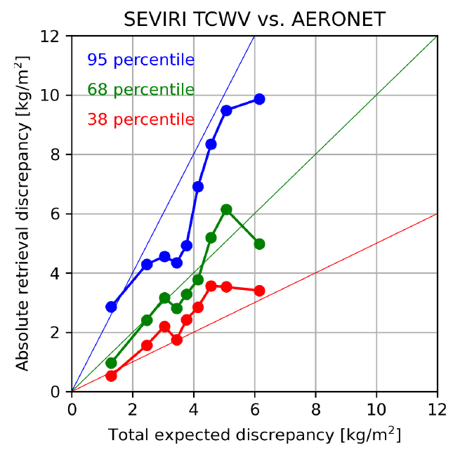
MSG-SEVIRI TCWV retrievals
Comparing absolute retrieval error |TCWV_{SEVIRI} - TCWV_{AERONET}| with total expected discrepancy
Compute per bin:
38, 68 and 95 percentile values
(0.5, 1 and 2 std)
relation to expected retrieval error
Distribution of retrieval errors
roughly Gaussian
Notes:
alleine starten lassen

Slide 35
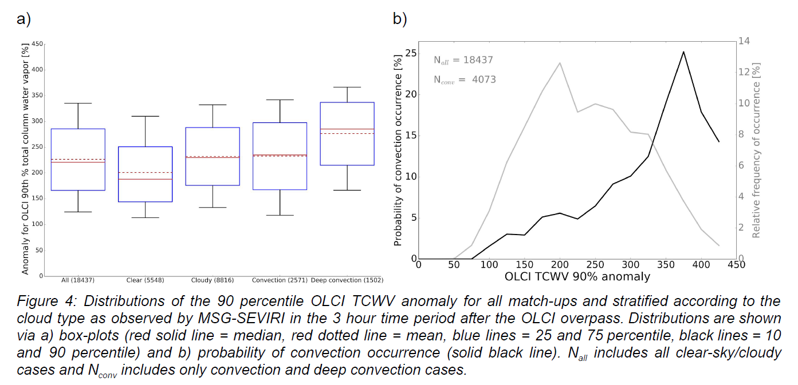
CI probability from TCWV obs
Notes:
alleine starten lassen

Slide 36
Data (Future data)
Geostationary satellite MSG/SEVIRI (2022: MTG/FCI(,LI,IRS))
Time resolution: 15 min.
Spatial resolution: ~ 4x7 km²
Variables from SEVIRI: CF, COT, REF, CPH, CWP, CTP, CTH, CTT, (IWV)
IWV, (Lightning, clear sky profiles of humidity and temperature )
Polar orbiting satellites:
Passive imagers MODIS + MERIS/AATSR (2017 Sentinel 3 a/b/c/d, 2020 POST-EPS):
Time resolution: ~ 2 times daily (n times!)
Spatial resolution: ~ 1x1 km² (0.5kmx0.5km)
Variables: CF, COT, REF, CPH, CWP, CTP, CTH, CTT, IWV
Active instruments CPR and CALIOP ( 2020 Earthcare , but difficult orbit for Polar):
Time resolution: ~ 2 times daily
Spatial resolution: 1-d track
Variables: vertical profiles of clouds, cloud typing
Ground-based observations GNSS:
Time resolution: 15 min.
Spatial resolution: ~400 stations in German network
Variable: IWV
Notes:
alleine starten lassen

Slide 37
WP-C1-1 Acquisition and evaluation of satellite observations and related products (m1-m6)
What done so far:
Adjustment of MERIS and MODIS IWV retrieval algorithms for OLCI
Some technical updates
Extended collection of OLCI L1 and L2 data (EUMETSAT CODA) retrieval of IWV (2016-2019)
Extended collection of MSG cloud products (2016-2019)
preparing switch to MSG-SEVIRI CPP CLAAS Ed. 2 → improved cloud products, mainly cloud (cirrus) detection (avail. Until 2017)
Collection of MSG L1 native data (CM-SAF) (2018-2019)
Python satpy tool for reading in this data format
Request for COSMO data (DWD) → rather do comparison with ICON data from Klaus
Extended collection of GPS IWV data in Germany (2013-2019)
Preparation of various datasets for ingestion into MSG-SEVIRI IWV retrieval (RTTOV)
Climatological atmospheric profiles and surface variables based on 30y ERA5
Notes:
alleine starten lassen

Slide 38
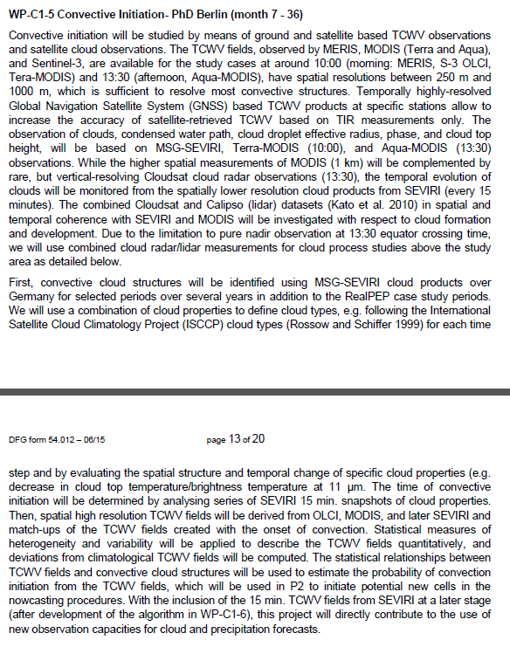
WP-C1-5 Convective Initiation (m7-m36)
Method
Identify convective cloud structures using MSG-SEVIRI cloud products (years 2016-2019) → determine time of convective initiation → Each time step evaluate spatial structures and temporal change in specific cloud properties
Combine with spatial high resolution IWV fields from OLCI, MODIS (later MSG) → cases with not too many clouds in morning
Compute measures of heterogeneity and variability to describe IWV fields quantitatively, deviations from climatological IWV fields.
Study statistical relationship between IWV field measures and convective cloud structures → estimate probability of convective initiation from IWV fields → used in P2 to initiate potential new sells in nowcasting procedures
Later (Phase 2), include newly developed Meteosat Third Generation (MTG) IWV fields!
Has water vapor channel
Higher temporal and spatial resolution
Notes:
alleine starten lassen

Slide 39
WP-C1-6: Development of IWV algorithm for MSG V1 (m1 – m36)
Development of new IWV retrieval algorithm using MSG-SEVIRI TIR measurements
Resulting IWV fields: cloud-free scenes above land with spatial resolution of 4 km x 7km over Germany at 15 min. temporal resolution
1D-var inversion scheme, RTTOV as forward model, a-priori knowledge from NWP + GPS
IWV retrieval uncertainty on pixel-basis (instrument, atmospheric profiles, surface emissivity)
Low precision due to surface emissivity variability → constrain MSG-SEVIRI IWV products using the IWV products from dense GNSS network in Germany with 15 min. temporal resolution (as well as OLCI and MODIS IWV products)
Also use GNSS IWV for validating the new IWV product, also during development
M-C1-4: Provision of MSG-based IWV and CI algorithms (m36)
Notes:
alleine starten lassen

Slide 40
Current work & Outlook
Notes:
alleine starten lassen

