Slide 1
Climate model PArameterizations informed by RAdar (PARA)
PHD(Uni Bonn): Nikolaos Papaevangelou
PHD(Uni Leipzig): Sabine Hörnig
Pls: Silke Trömel, Clemens Simmer, Johannes Quaas
PROM Programme
Institute for Geosciences, Department of Meteorology, Uni Bonn

Slide 2
Overall motivation of PARA
The overall goal of PARA is to evaluate and improve the representation of microphysical processes in ICON-GCM exploiting high-resolved polarimetric radar observations.
DWD radars $\sim$ 1km
ICON GCM $\sim$ 150km
BoXPol - JuXPol Radars $\sim$ 0.15Km

Slide 3
Work Programme
WP1
Spatial sub-grid scale variability of cloud ice (D<Dagg)
WP2
Aggregation
WP3
Melting of Precipitation
The project focuses on the following processes:
WP4
Evaporation
Where Dagg=100µm is based on the smallest size particle which is assigned to snow in ICON model.

Slide 4
Aim of WP1: (Uni Bonn)
The aim of WP1 is to provide the mean value and variance of:
Ice Water Content IWC (Ice)
Total number Concentration $N_{t}$ (Ice)
Mean Volume Diameter $D_{m}$ (Ice)
for each radar site as a function of height, using polarimetric radar measurements and applying the most recent ice microphysical retrievals (Ryzhkov et al. 2018).

Slide 5
Data and Methodology

Slide 6
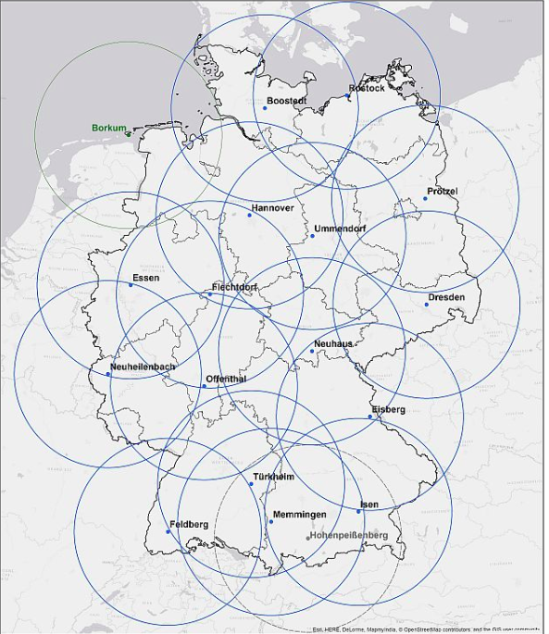
Data
Polarimetric radar data from the:
Radar network of DWD with C – band
Weather radars.
BoXPol X – band radar
JuXPol X – band radar
Jülich
Bonn
Fig. 1) Radar network of DWD. Seventeen C-band weather radar systems cover Germany completely.

Slide 7
Methodology - Ice microphysical retrievals
This study uses the most recent ice microphysical retrievals by Ryzhkov et al. (2018).
$D_{m}$= -0.1 + 2.0( ${\frac{Z_{DP}}{K_{DP} λ})}^{1/2}$
IWC= 4 x ${10}^{−3}$ $\frac{K_{DP} λ}{1−{Zdr}^{−1}}$
log($N_{t}$) = 0.1Z – 2log(γ) - 1.33
Τhe method is more accurate in stratiform clouds where significant riming is less likely and in areas of higher $Z_{DR}$.

Slide 8
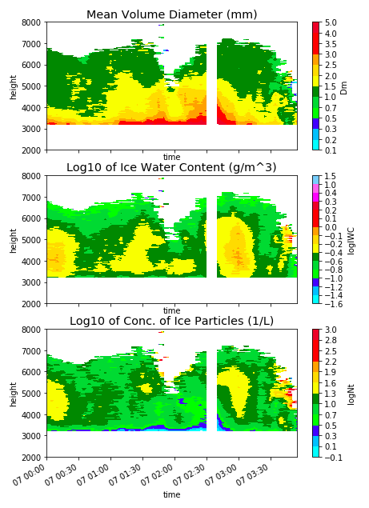
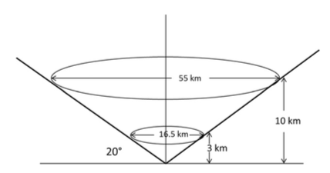
Methodology – Quasi Vertical Profiles
Azimuthal averaging of the radar data at antenna elevation angles between 10$°$–20 $°$
(representation
height-vs-time)
Fig. 2) Quasi Vertical Profile methodology
But the aim of WP1 is to provide IWC,Nt,Dm
for ice crystals.
Fig. 3) QVPs of Dm, logIWC and logNt (for entire particles)
for the rain event 07/10/2014 with BoxPol radar .

Slide 9
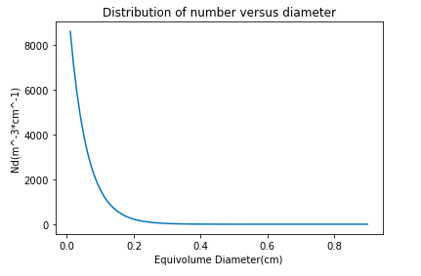
Methodology - Ice and snow component of IWC, ${ D}_{m}, N_{t}$
Ulbrich (1983)
$${Intercept: N}_{0}=\frac{4N_{t}}{D_{m}}$$
〖𝐼𝑛𝑡𝑒𝑟𝑐𝑒𝑝𝑡: 𝑁〗_0=(4𝑁_𝑡)/𝐷_𝑚
Parameter: λ = $\frac{4}{D_{m}}$
Parameter: λ = 4/𝐷_𝑚
…assuming that
$$N_{D}=N_{0}exp⁡(−λD)$$
…assuming that
𝑁_𝐷=𝑁_0 exp⁡(−𝜆𝐷)
IWC$=\int_{0.1}^{max}{ρ_{s,i}{(D)D}^{3}N_{D}dD }$
IWC=∫_(𝟎.𝟏)^𝒎𝒂𝒙▒〖𝜌_(𝑠,𝑖) 〖(𝑫)𝑫〗^𝟑 𝑵_𝑫 𝒅𝑫 〗
$D_{m}=$ $\sqrt{\frac{IWC}{1.31 {10}^{−5}N_{t}}}$
𝑫_𝒎= √(𝑰𝑾𝑪/(𝟏.𝟑𝟏 〖𝟏𝟎〗^(−𝟓) 𝑵_𝒕 ))
$$N_{t}=\int_{0}^{D}{ N_{D}dD }$$
𝑵_𝒕=∫_𝟎^𝑫▒〖 𝑵_𝑫 𝒅𝑫 〗
For ice and snow respectively
Ice
Where:
Snow: $ρ_{s}=0.2D^{−1}$
Ice:${ ρ}_{i}=0.247D^{−0.377}$

Slide 10
Issues on WorkPackage 𝐈

Slide 11
Issues on WorkPackage 𝐈 - Statistical Errors
“Noisy” measurements
Standard Deviation of $K_{DP}$ and $Z_{DR}$
SD($K_{DP})$ $\sim$ 0.13 deg/km
SD($Z_{DR})$ $\sim 0.24$ dB
Uncertainties of IWC, $N_{T}$, $D_{m}$
IWC$\sim 0.35±0.22 \frac{g}{m^{3}}$
Log($N_{T}$) $\sim$ $0.77±0.52 \frac{1}{L}$
$D_{m}$ $\sim$ 2.04 $±$ 0.68 mm
QVP methodology
Reduces the statistical errors of microphysical retrievals
┼
Coarse resolution which cannot provide sub-grid scale variability
⎻

Slide 12
Results(so far)

Slide 13
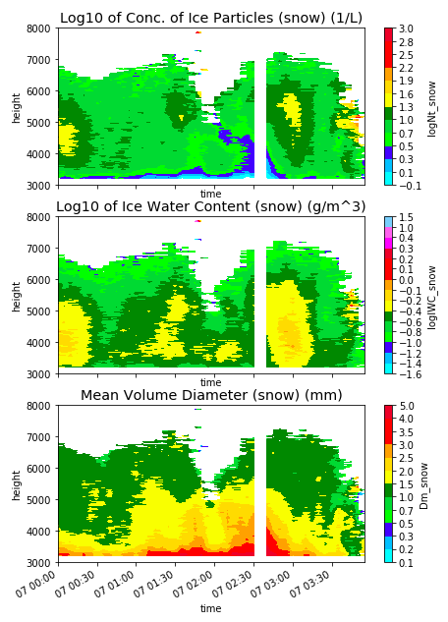
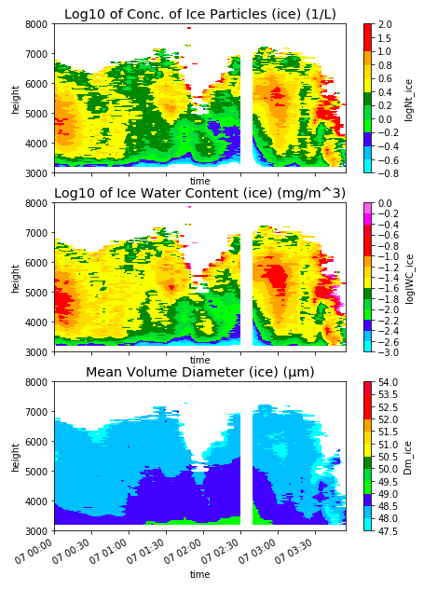
Rain Event 7/10/2014 (BoXPol radar)
Snow
Ice
The snow retrievals are in line with in-situ measurements in stratiform clouds with embedded convection in Northern China
(Hou et al. 2014).
The range of values of ice retrievals is identified with the in-situ measurements in cirrus midlatitude clouds (Orikasa et al. 2012, Sean et al. 2007)
18° elevation PPI scans were used.
$K_{DP}$ was calculated with the approach based on Vulpiani et al. 2012.
K_𝐷𝑃 was calculated with the approach based on Vulpiani et al. 2012.

Slide 14
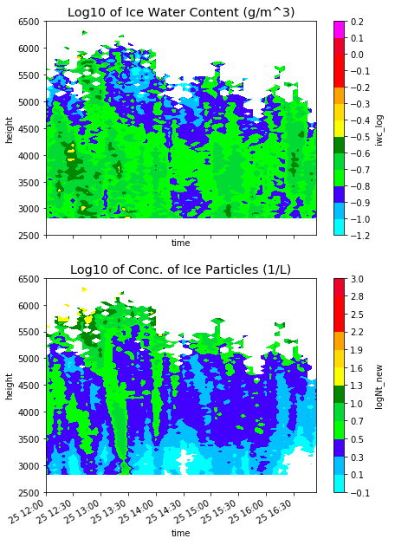
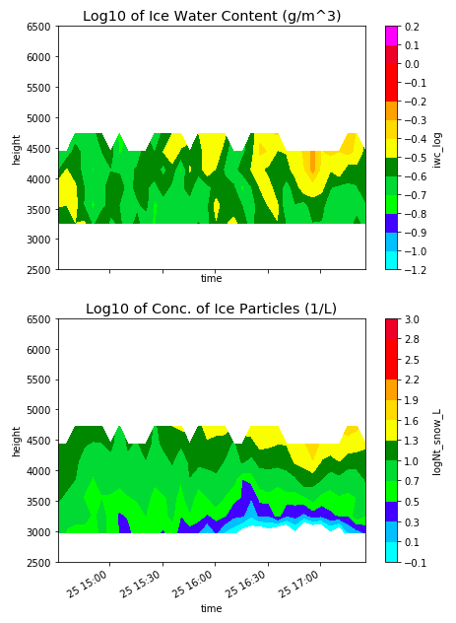
Rain Event 25/07/2017 (BoXPol-Essen radar)
BoxPol(snow)
Essen(snow)

Slide 15
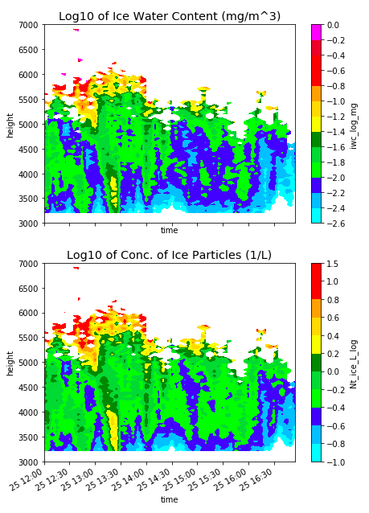
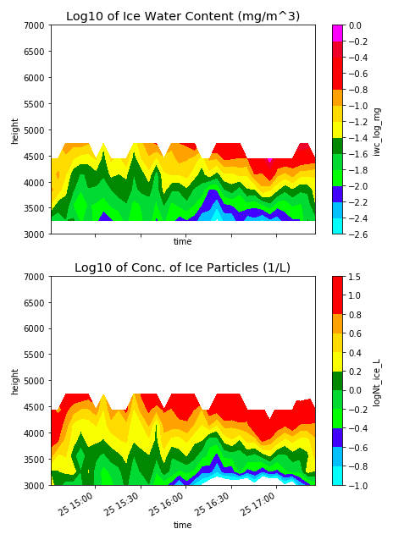
Rain Event 25/07/2017 (BoXPol-Essen radar)
BoxPol(Ice)
Essen(Ice)

Slide 16
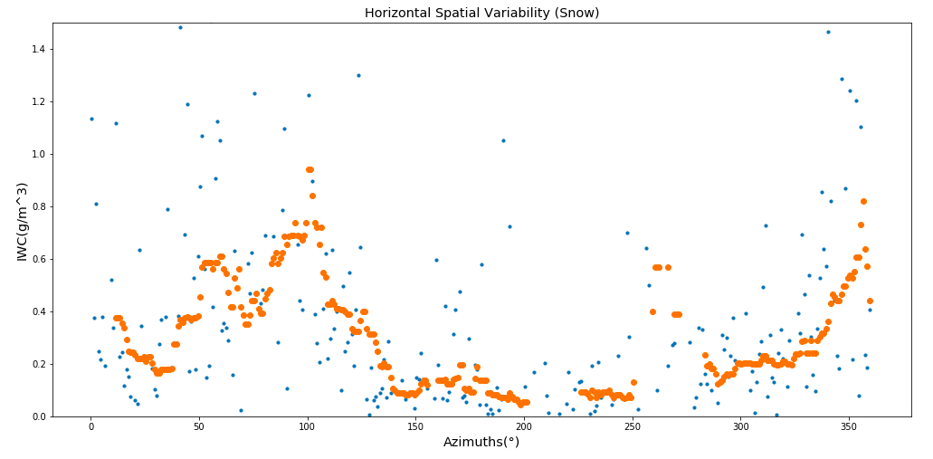
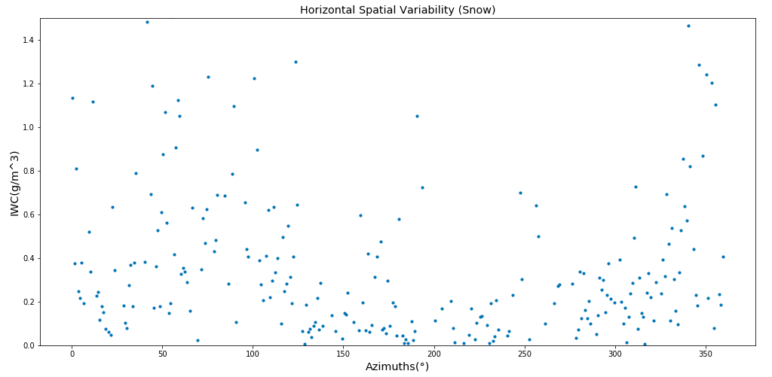
Sub-grid scale Variability
25/07/2017 BoXPol Radar
With the QVPs we lose
the variability of ice in azimuths.
The high uncertainty lead us
to use moving average.
Moving average with: W=20, M_C=10
IWC= 0.35 $±$0.06 $\frac{g}{m^{3}}$

Slide 17
Summary
Aim of WP1
Mean value and variance of IWC,Dm,Nt for ice.
The problem
Distinction ice and snow.
Noisy measurements.
1
2
The solution
Exponential distribution.
QVP methodology.
Moving average.
Results
For the first 5 cases, the range of values is identified with in situ measurements.
3
4
Future work
More cases using mainly the DWD radar network.
5

Slide 18
THANK YOU FOR YOUR ATTENTION!
QUESTIONS?

