Slide 1
PROM – IMPRINT Understanding Ice Microphysical Processes by combining multi-frequency and spectral Radar polarImetry aNd super-parTicle modelling
Leonie von Terzi, Stefan Kneifel (Uni Köln)
Jan-Niklas Welss, Axel Seifert (DWD)
A. Myagkov (RPG), J. Dias Neto, V. Schemann (Uni Köln)

Slide 2
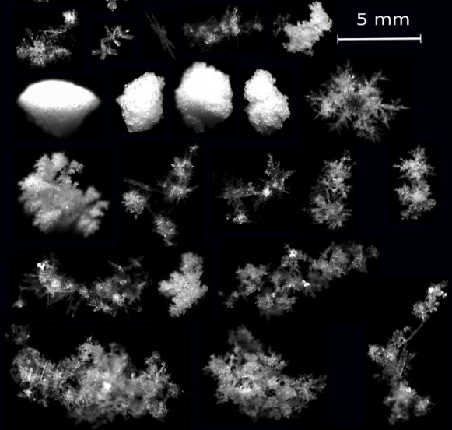
Motivation and Objectives
Insufficient understanding of key ice microphysical process (IMP):
Aggregation
Riming
Secondary Ice
Observational approach: Combined observations using spectral Polarimetry and Multi-frequency radar
T. Garret, U. Utah
Modelling approach:
ICON-LEM (3D): Nested simulations with high (600m) horizontal resolution and 2-moment bulk microphysics
McSnow (1D): Lagrangian super-particle model allows to implement very detailed ice microphysics
Simulation of synthetic observations using forward operator PAMTRA

Slide 3
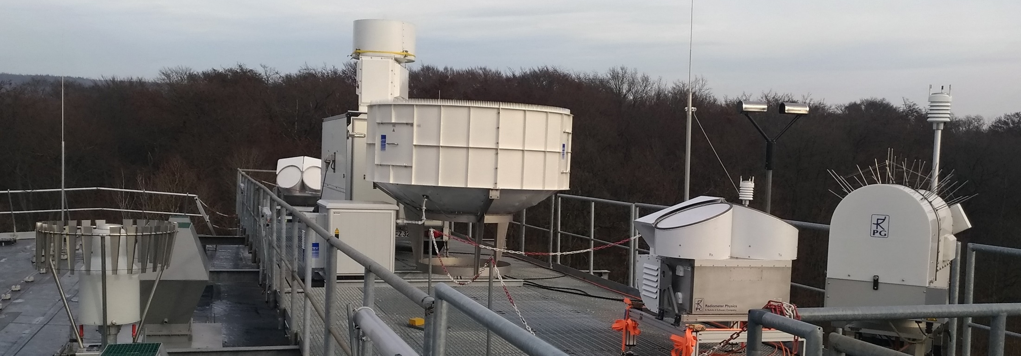
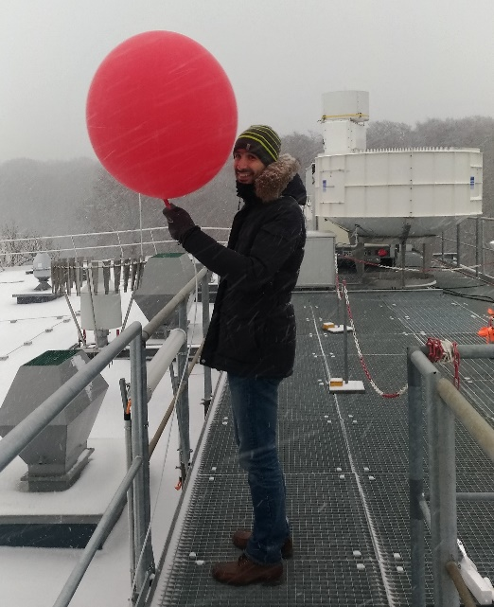
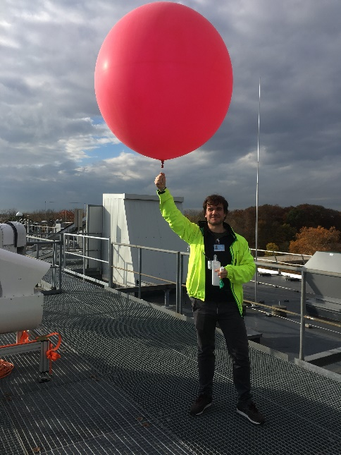
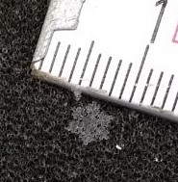
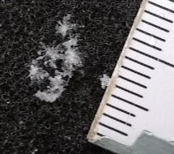
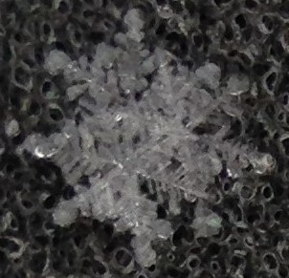
First successful winter campaign: TRIPEx-pol
Ka-Band (LDR)
11/2018 – 02/2019
Polarimetric W-Band
New X-Band
W-Band
(LDR)
20 Radiosondes launched

Slide 4
Example: Combined view using multi-frequency, Doppler spectra and polarimetry
Snowfall at the ground
X, Ka, W Band vertically pointing (Doppler spectra)
DWR = Ze(Ka)-Ze(W) shows enhancement when snowflakes are getting larger (>2-3mm)
Very good agreement with Parsivel on the ground! RS launched at 16 UTC
22.01.2019
Ze (Ka-Band)
„Ghost“ echos (W-Band)
DWR_Ka_W
Dmax (Parsivel)

Slide 5
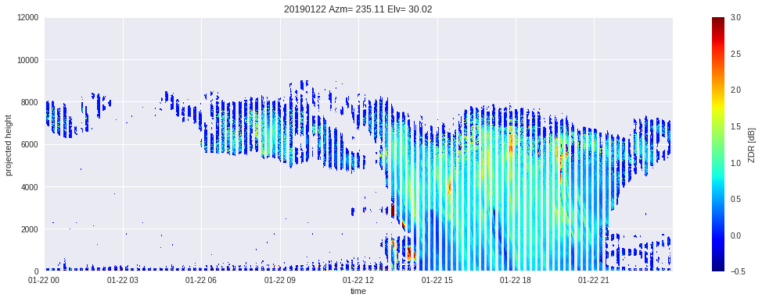
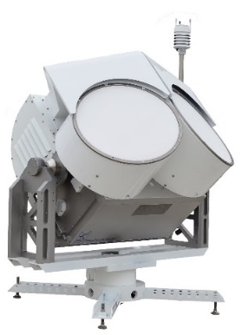
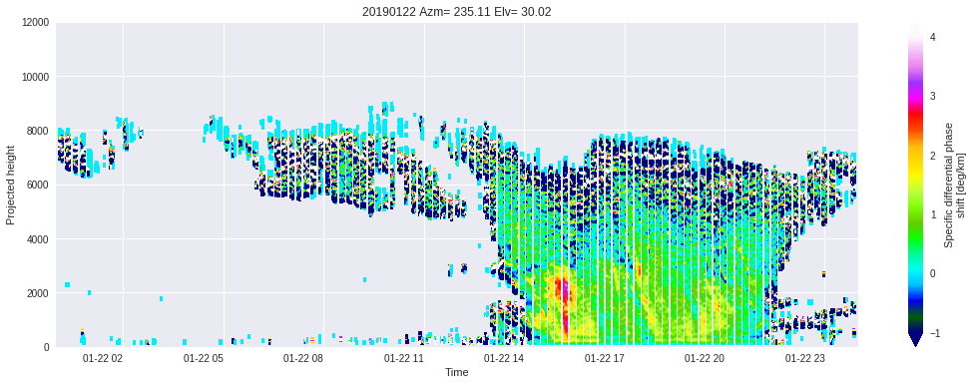
W-Band Polarimetry: „Classical“ Moments
ZDR
observations at elev=30°
Higher KDP and low ZDR where DWR indicates aggregation
Enhanced KDP within enhanced DWR regions
→ Are there only aggregates?
KDP

Slide 6
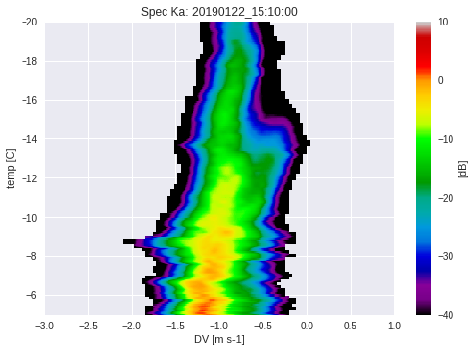
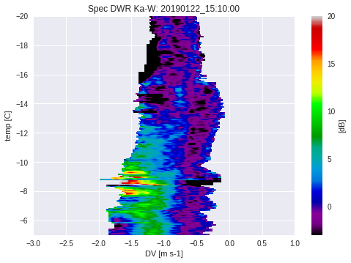
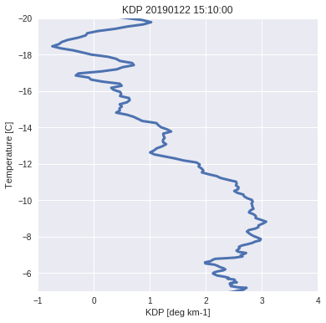
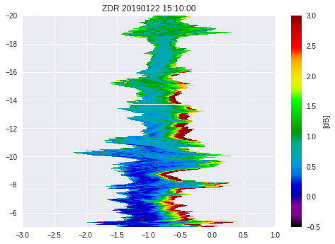
Combining spectra, polarimetry, multi-freq.
Spectral Ze (Ka)
Spectral DWR_Ka_W
A new spectral mode forms at below -16°C
Further below, the DWR indicates aggregation
A new spectral mode forms at below -16°C
KDP (W, 10min avg.)
Spectral ZDR (W)
Spectral ZDR and KDP start to increase at -16°C
SIP?
We need model to see which process is responsibel

Slide 7
ICON-LEM simulations (entire campaign!)
ICON-LEM + PAMTRA
Observations
Ze (Ka)
Ze (Ka)
Mean Doppler velocity
Mean Doppler velocity
DWR_Ka_W
DWR_Ka_W

Slide 8
Next steps (U. Köln):
Reprocess Tripex-pol dataset (Doppler spectra matched in time and space, corrected for artefacts, bias and attenuation correction, quality flags)
Prepare case overview including information about dominant processes (aggregation, riming, secondary mode, etc.)
Forward simulate McSnow output for specific case studies using simplified polarimetric forward operator (T-Matrix, sZDR, KDP)

