Slide 1
An efficient volume scan polarimetric radar forward OPERAtor to improve the representaTION of HYDROMETEORS in the COSMO model (Operation Hydrometeors)
V. Pejcic, S. Trömel, C. Simmer (Uni Bonn)
j. Mendrok, U. Blahak (DWD)

Slide 2
Objectives and Major goals
Exploitation of radar polarimetry for quantitavive process detection and model evaluation
Project: Operation Hydrometeors
Provide efficient polarimatiric forward operator required for fusion of radar polarimetry and atmospheric modeling
Radar Polarimetrie:
Evaluation of the hydrometeor (HM) types and mean particle size representation in DWD‘s COSMO/ICON-LAM
Atmospheric modeling:
Extend current non-polarimetric Forward operator to polarimetry assuming spheroids at precipitation radar wavelengths

Slide 3
Objectives and Major goals
Exploitation of radar polarimetry for quantitavive process detection and model evaluation
Project: Operation Hydrometeors
Provide efficient polarimatiric forward operator required for fusion of radar polarimetry and atmospheric modeling
Radar Polarimetrie:
Evaluation of the hydrometeor (HM) types and mean particle size representation in DWD‘s COSMO/ICON-LAM
Atmospheric modeling:
Extend current non-polarimetric Forward operator to polarimetry assuming spheroids at precipitation radar wavelengths

Slide 4
Standard approach for hydrometeor classification (HMC)
1. Number of hydrometeor classes: M(i=11)
HMC (general cases)
Zrnic et al. 2001 adapted by Evaristo et al. 2013
M=11,
Types: light rain, moderate rain, heavy rain, rain dominated by large drops, rain/hail mixture, graupel and/or small hail, hail, dry snow, wet snow, horizontally oriented ice crystals, and vertically oriented ice crystals
HMC (warm season and convective)
Dolan and Rutledge 2009
M=7,
Types: rain, drizzle/light rain, high-density graupel/ precipitation ice, ice crystals, aggregates, and vertically aligned ice
HMC (cold seasons and stratiform)
Thompson et al. 2014
M=7,
Types: classes plates, dendrites, ice crystals, dry aggregated snowflakes, wet snow, freezing/frozen raindrops, and rain
COSMO/ICON-LAM
M=6,
Types: hydrometeor classes cloud water, rain, cloud ice, snow, graupel, and hail

Slide 5
Standard approach for hydrometeor classification (HMC)
1. Number of hydrometeor classes: M(i=11)
2. Number of used variables: V(j=5)
- Reflectivity (ZH in dBZ)
- Differential Reflectivity (ZDR in dB)
- Cross-Correlation Coefficient (RHOHV)
- Specific Differential Phase (KDP in deg)
- Temperature from sounding (T in °C)
Zrnic et al. 2001

Slide 6
Standard approach for hydrometeor classification (HMC)
1. Number of hydrometeor classes: M(i=11)
2. Number of used variables: V(j=5)
3. EM Scattering Simulation:
ixj Ranges of PolVar for specific HM type
T-Matrix scattering model:
Calculation of backscattering cross section for specific HM
Approximation for ice HM:
complex geometries
Dielectric properties
Size/orientation distributions

Slide 7
Standard approach for hydrometeor classification (HMC)
1. Number of hydrometeor classes: M(i=11)
2. Number of used variables: V(j=5)
3. EM Scattering Simulation:
ixj Ranges of PolVar for specific HM type
4. Fuzzification:
P_{i}(V_{j}) Membership functions
P_{i}(V_{j}) is the membership function of the j-th variable for the i-th class
P_{i}(V_{j})
i = hydrometeor class number
j = number of the variable

Slide 8
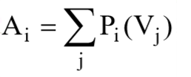
Standard approach for hydrometeor classification (HMC)
1. Number of hydrometeor classes: M(i=11)
2. Number of used variables: V(j=5)
3. EM Scattering Simulation:
ixj Ranges of PolVar for specific HM type
4. Fuzzification:
P_{i}(V_{j}) Membership functions
5. Aggregation Values per radar resolution bin:
P_{i}(V_{j}) is the membership function of the j-th variable for the i-th class
P_{i}(V_{j})
i = hydrometeor class number
j = number of the variable

Slide 9
Standard approach for hydrometeor classification (HMC)
1. Number of hydrometeor classes: M(i=11)
2. Number of used variables: V(j=5)
3. EM Scattering Simulation:
ixj Ranges of PolVar for specific HM type
4. Fuzzification:
P_{i}(V_{j}) Membership functions
5. Aggregation Values per radar resolution bin:
6. Defuzzification per radar resolution bin:
Find the maximum Ai and output the ith class

Slide 10
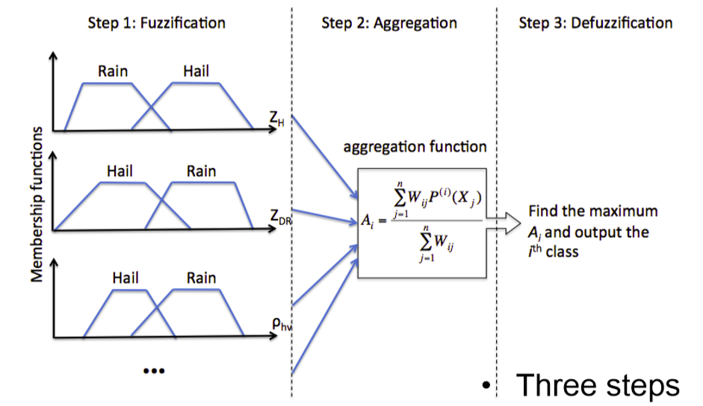
Standard approach for hydrometeor classification (HMC)
1. Number of hydrometeor classes: M(i=11)
2. Number of used variables: V(j=5)
3. EM Scattering Simulation:
ixj Ranges of PolVar for specific HM type
4. Fuzzification:
P_{i}(V_{j}) Membership functions
5. Aggregation Values per radar resolution bin:
6. Defuzzification per radar resolution bin:
Find the maximum Ai and output the ith class
source: G. Zhang (lecture slides)

Slide 11
Standard approach for hydrometeor classification (HMC)
1. Number of hydrometeor classes: M(i=11)
2. Number of used variables: V(j=5)
3. EM Scattering Simulation:
ixj Ranges of PolVar for specific HM type
4. Fuzzification:
P_{i}(V_{j}) Membership functions
5. Aggregation Values per radar resolution bin:
6. Defuzzification per radar resolution bin:
Find the maximum Ai and output the ith class
A Simple Example
rain
3 HM classes (rain, clutter, bio. Scatter)
3 radar variables (Z, Z_{DR} and ρ_{hv} )
Measurements: Z = 25 dBZ, Z_{DR} = 3.0 dB, ρ_{hv} = 0.55
clutter
biolog.
Klasse | P(Z) | P(Z_{DR}) | P(ρ_{hv}) | A
Rain | 1.0 | 0.5 | 0.0 | 1.5
Clutter | 1.0 | 0.0 | 0.5 | 1.5
Biolog. | 0.5 | 1.0 | 1.0 | 2.5

Slide 12
Challenges for direct comparison using common hydrometeor classifications (HMC)
Comparison:
Comparison between modelled and observed HM/PolVar only statistically (time/spcae shifts)
The A-priori definition of different HM classes and numbers
Unphysical class attributions:
Uncertain of HM class properties define by theoretical scattering simulations (solid phase)
Tyynetla et al. 2011
Impact of radar observation accuracy on HM typing
Park et al. 2009
Reliability of HMs in mixtures:
A less represented HM class may be identified as dominant in HM mixtures due to disproportional impact on PolVar

Slide 13
Proposed dual strategy
Outlook for later Work Packages
Strategy 1:
Comparison of modelled hydrometeor space-time distributions with a sophisticated polarimetry-based HMC (classification AFTER clustering - similarity of variables and smoothness of boundaries) (Grazioli et al. 2015)
Strategy 2:
A direct comparison of simulated and observed distributions of polarimetric moments
PolVars: ZH, ZDR, RHOHV, KDP, AH, ADR
C-band network (DWD) and X-band (Uni Bonn / FZ Jülich)
Histograms of PolVar stratified according to hydrometeor types/cluster
The A-posteriori definition of HMC classes and numbers / HMC on Cluster
Less sensitiv to instrument accuracy and miscalibration
Less sensitiv to theoretical simulations uncertainties

Slide 14
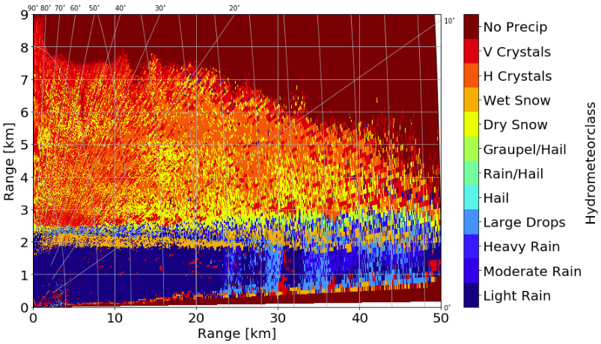
Useability of common hydrometeor classification schemes for model evaluation
WP1 + WP2
BoXPol (RHI, X-band) 2014.10.07 02:30 UTC
Aims WP1 and WP2:
WP1:
10 case study days (stratiform/convective)
WP2:
Apply HMC on case study days and build a reference for envisioned improvements
HMC befor/after 3D compositing?
Robustness of state-of-the art HMC?
Comparability to COSMO/ICON-LAM?
Zrnic et al. 2001

Slide 15
References:
Zrnic, D. S., A. V. Ryzhkov, J. M. Straka, Y. Liu, and J. Vivekanandan, 2001: Testing a procedure for the automatic classification of hydrometeor types. J. Atmos. Oceanic Technol., 18, 892–913.
Dolan, B., and S. A. Rutledge, 2009: A theory-based hydrometeor identification algorithm for X-band polarimetric radars. J. Atmos. Oceanic Technol., 26, 2071–2088.
Thompson, E.J., S.A. Rutledge, B. Dolan, V. Chandrasekar, and B.L. Cheong, 2014: A Dual-Polarization Radar Hydrometeor Classification Algorithm for Winter Precipitation. J. Atmos. Oceanic Technol., 31, 1457–1481, DOI: 10.1175/JTECH-D-13-00119.1
Evaristo, R., 2009: Microphysique et dynamique des systèmes précipitants en Afrique de l’Ouest. PhD Dissertation, University of Versailles.
Grazioli, J., D. Tuia, and A. Bern, 2015: Hydrometeor classification from polarimetric radar measurements: a clustering approach. Atmos. Meas. Tech., 8, 149–170, doi:10.5194/amt-8-149-2015.
Park, H. S., A. V. Ryzhkov, D. S. Zrnic, and K.-E. Kim, 2009: The hydrometeor classification algorithmfor the polarimetric WSR-88D: Description and application to an MCS. Wea. Forecasting, 24, 730–748, doi:10.1175/2008WAF2222205.1.
Tyynelä, J.,J. Leinonen, D. Moisseev, and T. Nousiainen, 2011: Radar Backscattering from Snowflakes: Comparison of Fractal, Aggregate, and Soft Spheroid Models. J. Atmos. Oceanic Technol., 28, 1365–1372, DOI: 10.1175/JTECH-D-11-00004.1
Thank you for your attention!
Questions?

Slide 16
APPENDIX

Slide 17
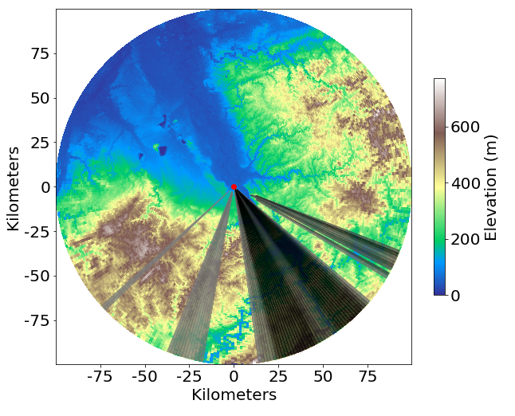
Ground Observation: BOXPol
Information: BoXPol
Radar: dual-pol X-band
Resoution: 5 min x 1° x [25m – 150m]
Frequenz: 9.3 GHz
Elevation: 10 (1° - 28°)
Range: 150km
Corrected: clutter, beam blockage attenuation (Z-PHI-Method)

Slide 18
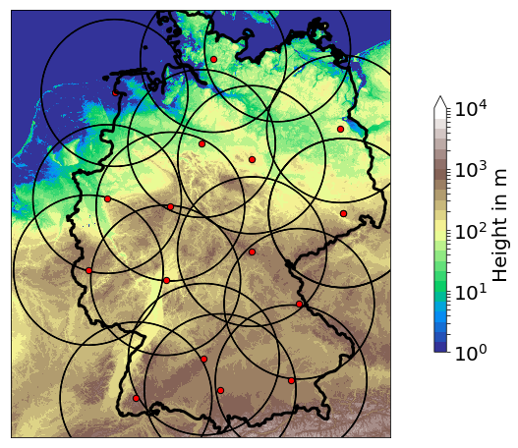
Ground Observation: RADOLAN
RADOLAN
5min x 1° x 1km
Information: RADar OnLine ANeichung
Radars: 17 dual-pol C-band
Resoution: 5 min x 1° x 1km
Frequenz: ~5 GHz
Elevation: terrain following (0.5° – 1.8°)
Range: 150 km
Corrected: clutter- and beam blockage (Bartels et al. 2004)
f=~5 GHz

Slide 19
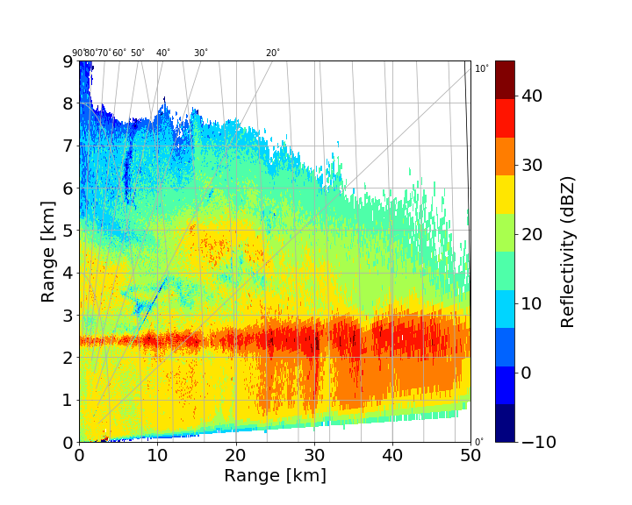
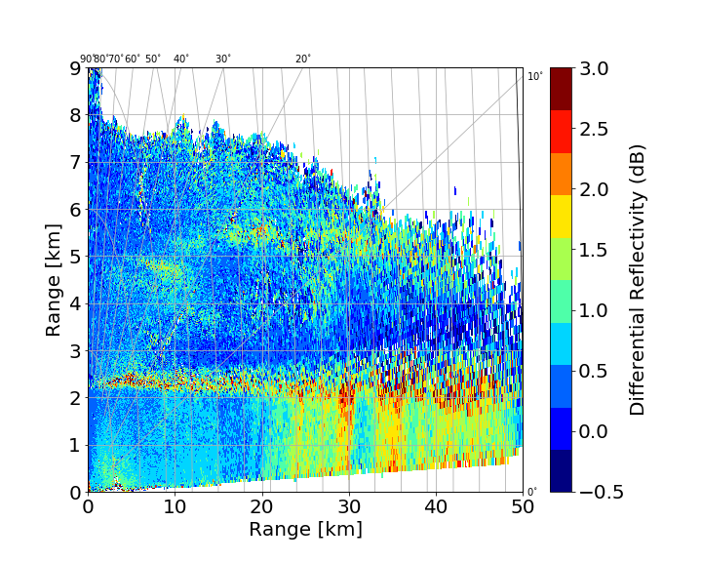
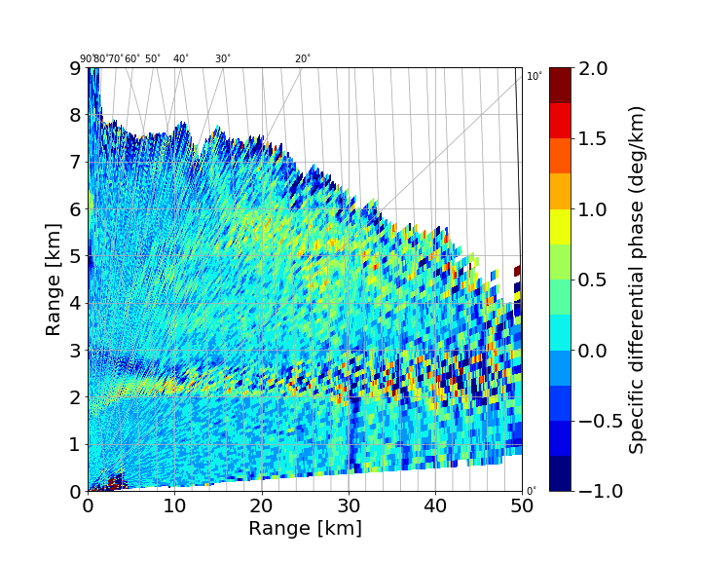
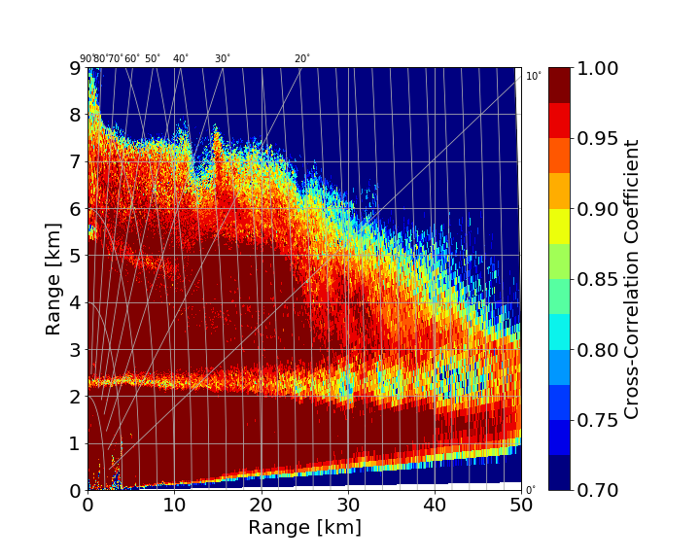
BoXPol (RHI, X-band) 2014.10.07 02:30 UTC

Slide 20
HMC [Zrnic et al. 2001]

